Slide 1

Eli
Local SEO powered by Erio
Google Business Profile management
for local and home service businesses
Notes:
Adapted from Merchynt White Label SMB Sales Deck: https://www.canva.com/design/DAG_eg4uScc/SN7lqhBPwd2RtmsseCcHpQ/edit. Original has example claims and placeholders which are not evidence of Erio results. Asset source https://www.merchynt.com/marketingassets.

Slide 2
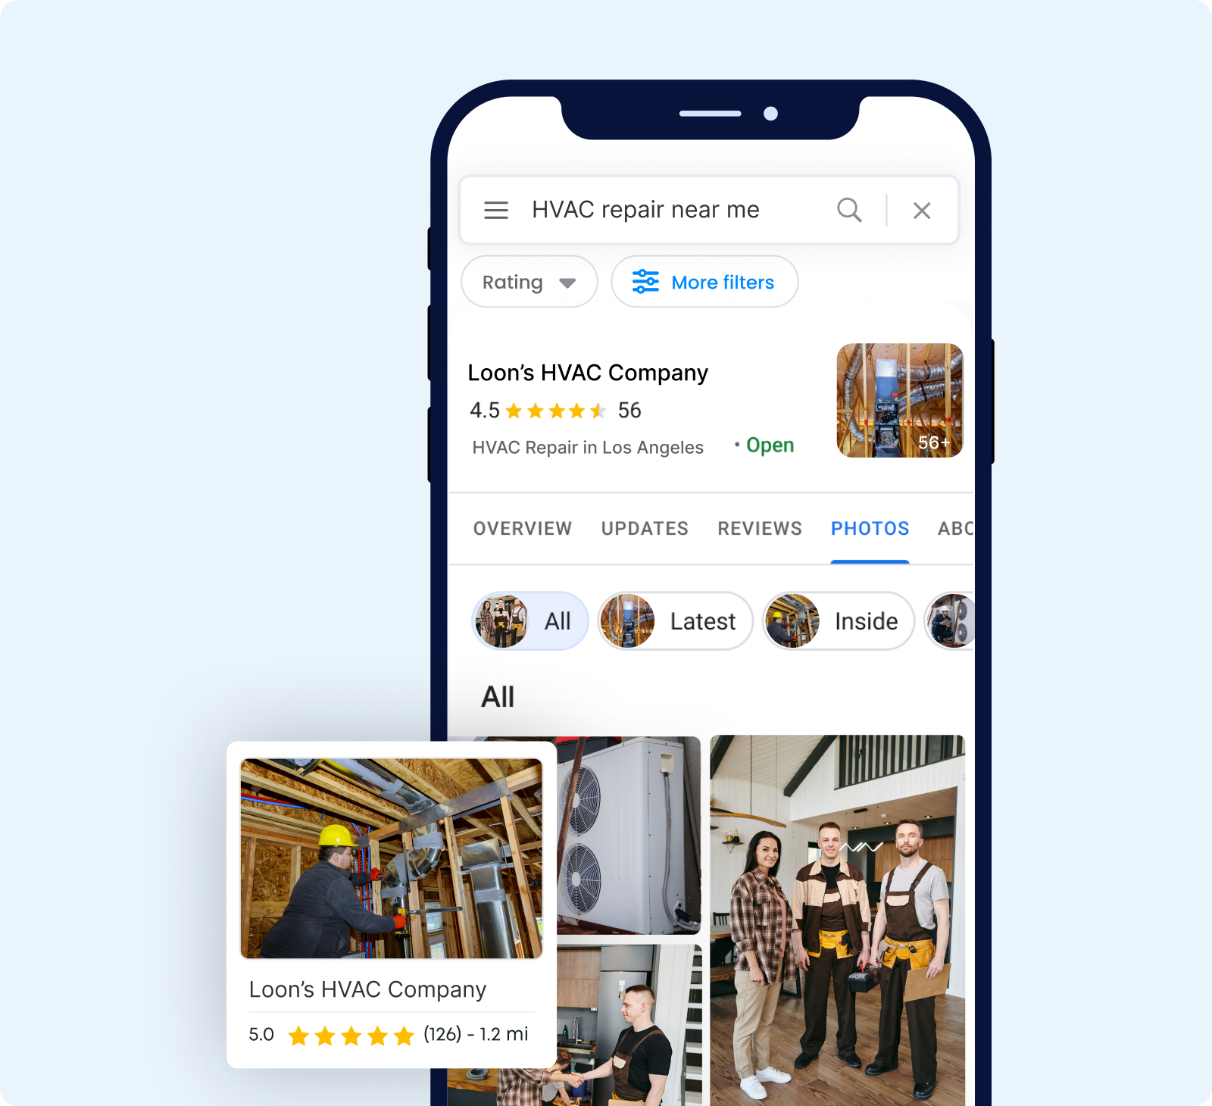
Your Google Business Profile
Customers use your profile to choose who to call
Accurate business details, useful photos, and recent reviews help customers understand your services.
Illustrative business profile
Notes:
Adapted from Merchynt White Label SMB Sales Deck: https://www.canva.com/design/DAG_eg4uScc/SN7lqhBPwd2RtmsseCcHpQ/edit. Original has example claims and placeholders which are not evidence of Erio results. Asset source https://www.merchynt.com/marketingassets.

Slide 3
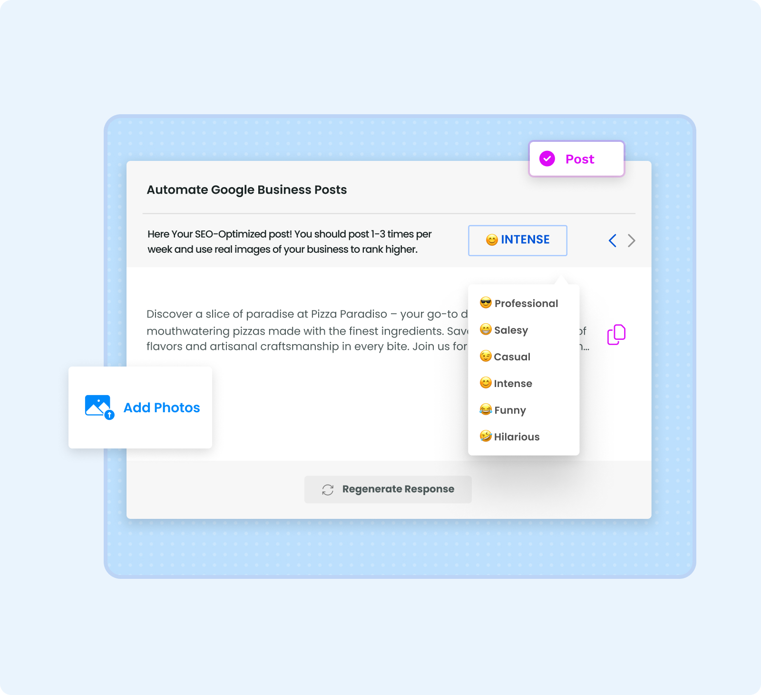
Eli handles recurring profile work
Profile optimization
Keep services and business information aligned with what you offer.
Ongoing content
Prepare Google posts and work with the photos and business updates you provide.
Notes:
Adapted from Merchynt White Label SMB Sales Deck: https://www.canva.com/design/DAG_eg4uScc/SN7lqhBPwd2RtmsseCcHpQ/edit. Original has example claims and placeholders which are not evidence of Erio results. Asset source https://www.merchynt.com/marketingassets.

Slide 4
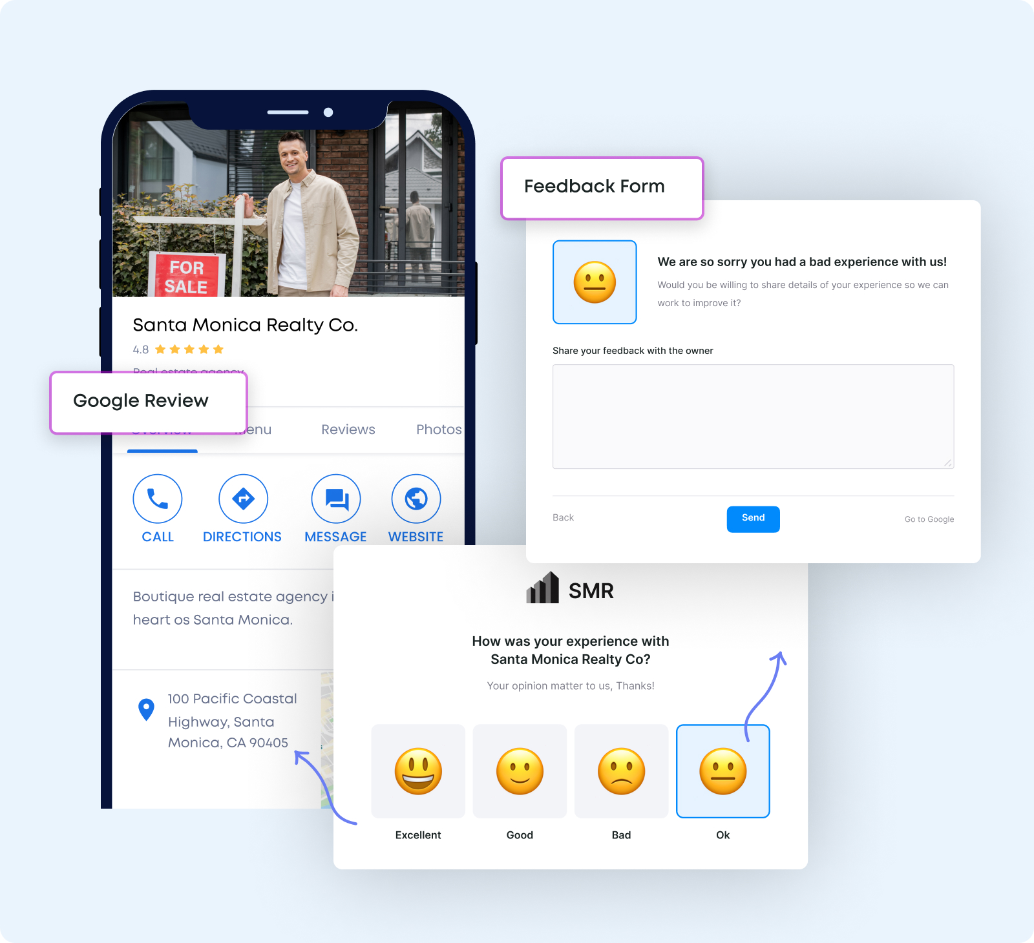
Reviews and customer feedback
Review responses
Eli prepares replies to Google reviews for your business.
Review reminders
Your updates can remind you to ask customers for honest reviews.
Notes:
Adapted from Merchynt White Label SMB Sales Deck: https://www.canva.com/design/DAG_eg4uScc/SN7lqhBPwd2RtmsseCcHpQ/edit. Original has example claims and placeholders which are not evidence of Erio results. Asset source https://www.merchynt.com/marketingassets. Email templates reviewed in Erio account include review reply approval and review-request reminders. Do not promise removal of legitimate negative reviews.

Slide 5
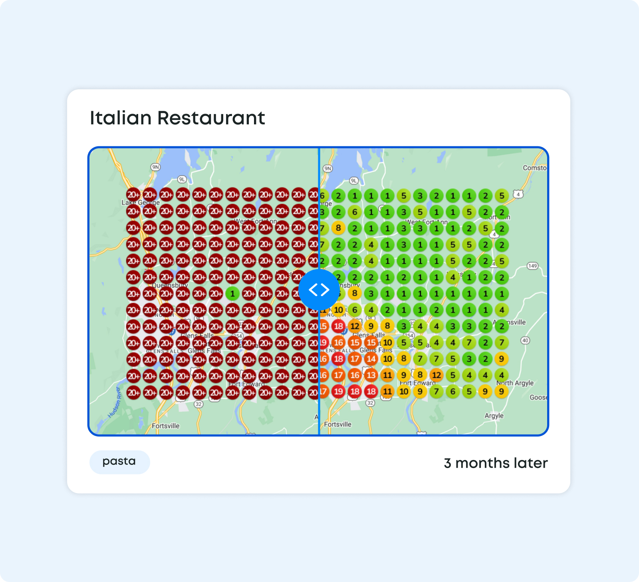
Progress you can see
Local ranking heatmaps
See how rankings vary across an area for the keywords you track.
Regular reports and activity updates help you review the work and results over time.
Illustrative heatmap
Notes:
Adapted from Merchynt White Label SMB Sales Deck: https://www.canva.com/design/DAG_eg4uScc/SN7lqhBPwd2RtmsseCcHpQ/edit. Original has example claims and placeholders which are not evidence of Erio results. Asset source https://www.merchynt.com/marketingassets.

Slide 6
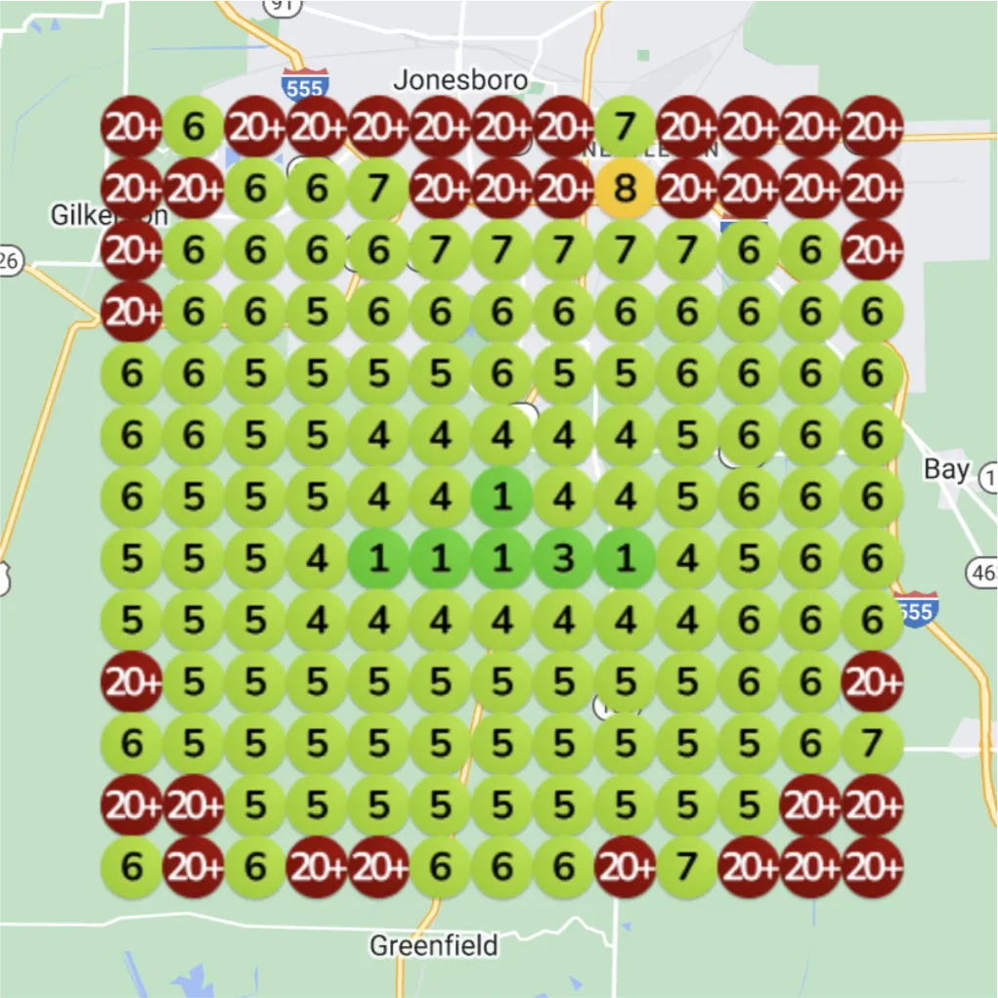
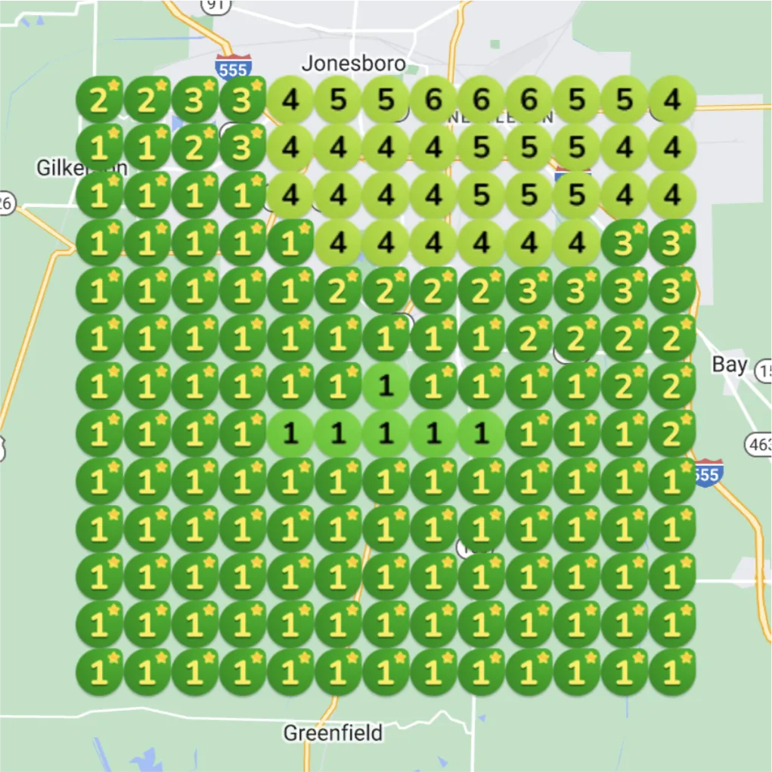
A contractor example
Keyword: water damage repair
Before
One month later
Notes:
Source https://www.merchynt.com/customer-success-stories Contractor filter. Keyword water damage repair. Vendor comparison label 1 month later. Images preserved without altering ranking evidence. Not an Erio client case or guarantee.

Slide 7
Your role
Share what makes your business different
Provide current business details and the services you want to promote.
Upload authentic photos and share business news for relevant content.
Review approval requests and tell Erio when your services change.
Notes:
Adapted from Merchynt White Label SMB Sales Deck: https://www.canva.com/design/DAG_eg4uScc/SN7lqhBPwd2RtmsseCcHpQ/edit. Original has example claims and placeholders which are not evidence of Erio results. Asset source https://www.merchynt.com/marketingassets. Based on approved client emails: welcome, content approval, photo uploads and business update requests.

Slide 8
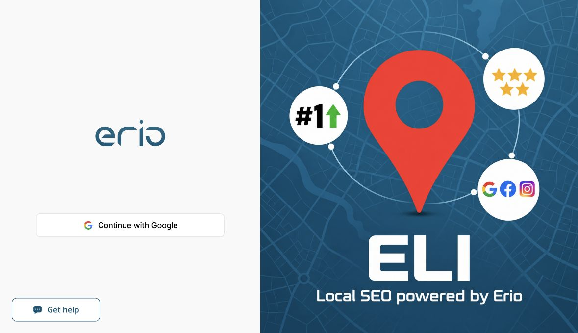
A clear view of the work
Your Erio portal
Access Eli at platform.erio.ai to review your activity and progress.
Updates from Erio Support
Client emails use support@erio.ai.
Notes:
Adapted from Merchynt White Label SMB Sales Deck: https://www.canva.com/design/DAG_eg4uScc/SN7lqhBPwd2RtmsseCcHpQ/edit. Original has example claims and placeholders which are not evidence of Erio results. Asset source https://www.merchynt.com/marketingassets. Account preferences: Erio, Eli, #005475 and #ffffff. Sender support@erio.ai. Custom portal domain still awaiting successful hosting activation; no live address promised on this slide.

Slide 9
The value of an additional customer
A simple revenue estimate
5 additional customers × $300 average revenue = $1,500 additional monthly revenue
Use your own numbers to explore the potential value of more customers.
Hypothetical example. Revenue is not profit, and outcomes are not guaranteed.
Notes:
Hypothetical arithmetic: 5 × $300 = $1500. No Erio service pricing included by user instruction. Official calculator source https://docs.google.com/document/d/1F2D37QWtaxJ4MJ8s-uaxsW4GmXoFCu_yvOrrU48A4tk/edit. Use consistent monthly units.

Slide 10
Your local SEO plan
Book a free 15-minute Rank Call at rank.erio.ai to review your profile and plan your next steps.
support@erio.ai
Notes:
Adapted from Merchynt White Label SMB Sales Deck: https://www.canva.com/design/DAG_eg4uScc/SN7lqhBPwd2RtmsseCcHpQ/edit. Original has example claims and placeholders which are not evidence of Erio results. Asset source https://www.merchynt.com/marketingassets. Pricing, contract terms and scope are agreed separately. No promised ranking, client counts, fabricated testimonial or performance guarantee.

